Slide 1


Université Panthéon-Assas Master 2 Ingénierie Statistique et Financière
Insurance Econometrics
Regression for Count Data
Joseph Lanfranchi, 2021-22

Slide 2
The effect of insurance contracts on health consumption
In this last lecture on modelling insurance behaviour, our goal is to explain how access to private or public health insurance induces the patient to increase their health care demand.
Indeed, risk pooling provided by public or private insurance contract is likely to create moral hazard from the insured party.
We make a distinction between ex ante and ex post moral hazard. This last term depicts a situation where people who hold health insurance consume more health services than would be optimal. This name has been chosen because the behavior occurs after the loss associated with the risk has occurred.
Joseph Lanfranchi ISF 2021-22

Slide 3
The effect of insurance contracts on health consumption
This effect arises because insurance companies pay for treatment rather than indemnifying the patient. As it is difficult to observe the necessary health service, patient can chose to over consume.
On the contrary, the term ex ante moral hazard refers to another type of asymmetric information situation where people chose to underprovide effort for protecting themselves or an asset after signing an insurance contract with an insurance company. This last behavior is denoted as ex-ante moral hazard.
Moral hazard may not be the only explanation for the positive relationship between health demand and insurance. The causality may be reversed with more fragile individuals choosing to insure themselves more extensively.
Joseph Lanfranchi ISF 2021-22

Slide 4
The effect of insurance contracts on health consumption
Health demand studies model data on the number of times that individuals consume a health service, such as visits to a doctor or days in the hospital in a given period.
In this chapter we will try to explain if the frequency of visits to general practitioners or non medic depends on the nature of the insurance of the patient.
In this context the dependent or response variable of interest is a nonnegative integer or count that we wish to explain or analyze in terms of a set of regressors. Unlike the classical regression model, the response variable is discrete, with a distribution that places probability mass at nonnegative integer values only.
For that matter, we will examine how Sas helps to run Poisson regression and negative binomial regression, which are two methods that are appropriate for dependent variables that have only non-negative integer values: 0, 1, 2, 3, etc. Usually these numbers represent counts of something, like number of people in an organization, number of episodes of sickness absenteeism, or number of arrests in the past year.
Joseph Lanfranchi ISF 2021-22

Slide 5
The effect of insurance contracts on health consumption
For years, people analyzed count data by ordinary linear regression and, for many applications, that method was adequate for the task.
However, Poisson and negative binomial regression have the advantage of being precisely tailored to the discrete, often highly skewed distribution of the dependent variable.
On the downside, Poisson regression has the disadvantage of being susceptible to problems of overdispersion that do not affect ordinary linear regression.
Overdispersion, discussed in detail later, can produce severe underestimates of standard errors and overestimates of test statistics. While there are some simple corrections for overdispersion, negative binomial regression is generally the preferred method whenever there is evidence for overdispersion.
Joseph Lanfranchi ISF 2021-22

Slide 6
Structure of the database
The data are a cross-section sample from the U.S. Medical Expenditure Panel Survey for 2003. The model will use a sample of the Medicare population aged 65 and higher.
Medicare is a national health insurance program in the United States, begun in 1966 under the Social Security Administration. In general, all persons 65 years of age or older who have been residents of the United States for at least five years are eligible for this program.
In this database, individual information is reported about individual characteristics – age, gender, years of education, if they are black or Hispanic –, about medical consumption – annual number of doctor visits, annual number of visits to health professional, but not doctor, number of chronic conditions, presence of activity limitation –, and insurance access – public Medicaid insurance, private insurance, employer provided private insurance –.
Medicaid is a federal and state assistance program that helps with medical costs for some people with limited income and resources. Medicaid also offers benefits not normally covered by Medicare, including nursing home care and personal care services.
Joseph Lanfranchi ISF 2021-22

Slide 7
Structure of the database
The interesting characteristics of count data distribution is the shape of this distribution and their first moments.
The distribution of the variable number of doctor visits has a very long right tail. 22% of the observations exceed 10, and more than 99% of the values are under 40. The proportion of zeros is quite high with 10,9%.
It should be noted that this percentage of zeros is relatively low for data about doctor visits, probably because the data pertain to the elderly population.
Samples of younger, and usually healthier population often have as many as 90% zero observations for some health outcomes.
The distribution of the variable of health professional visits contains a much higher proportion of zero visits (53%).
Joseph Lanfranchi ISF 2021-22

Slide 12
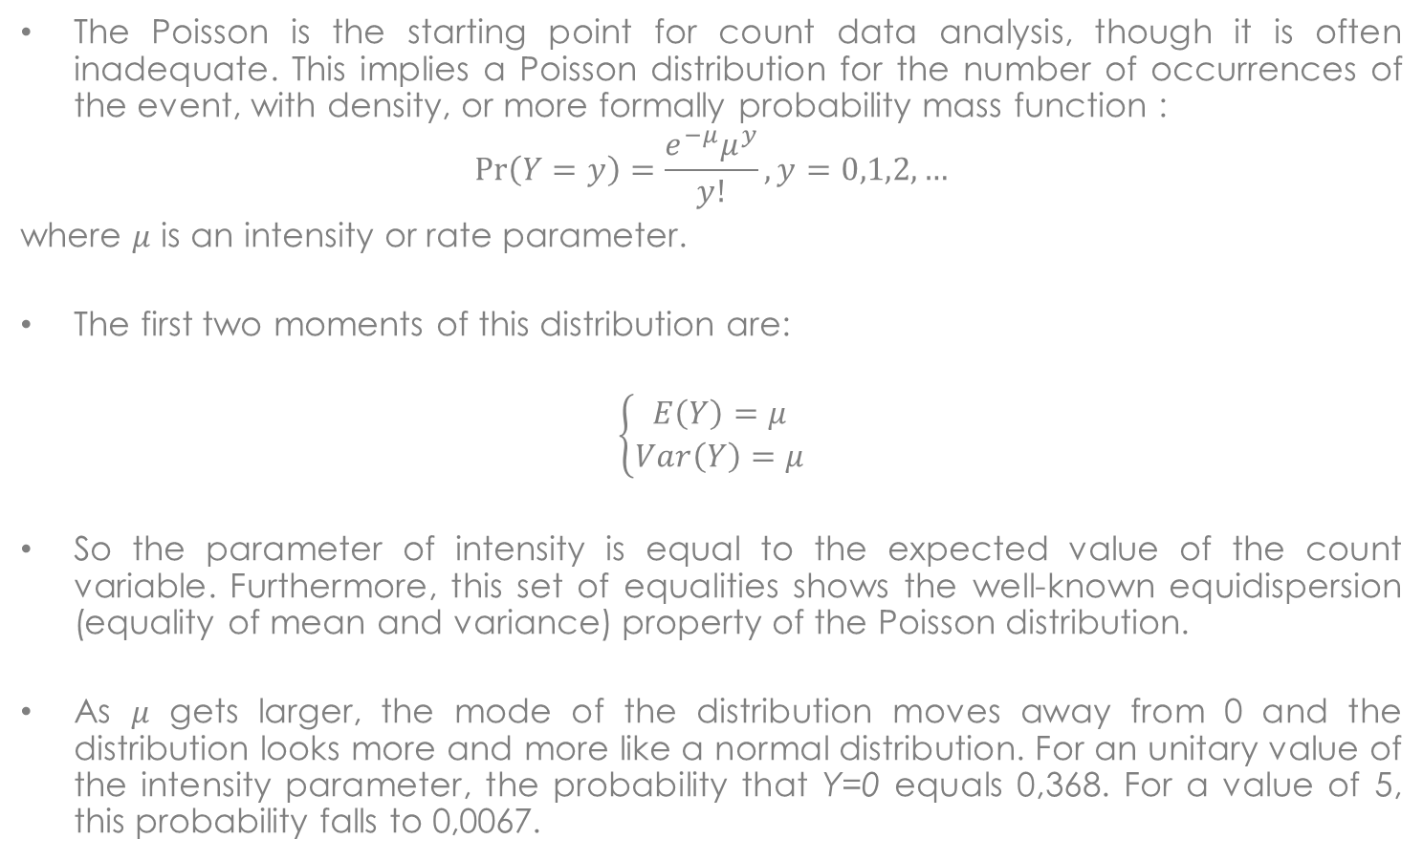
Count data model: The Poisson regression model
The Poisson is the starting point for count data analysis, though it is often inadequate. This implies a Poisson distribution for the number of occurrences of the event, with density, or more formally probability mass function :
$$\operatorname{Pr}\left(Y=y\right)=\frac{e^{−μ}μ^{y}}{y!}, y=0,1,2,…$$
where $μ$ is an intensity or rate parameter.
The first two moments of this distribution are:
$$\left\{\begin{aligned}E\left(Y\right)=μ \\ Var\left(Y\right)=μ\end{aligned}\right.$$
So the parameter of intensity is equal to the expected value of the count variable. Furthermore, this set of equalities shows the well-known equidispersion (equality of mean and variance) property of the Poisson distribution.
As 𝜇 gets larger, the mode of the distribution moves away from 0 and the distribution looks more and more like a normal distribution. For an unitary value of the intensity parameter, the probability that Y=0 equals 0,368. For a value of 5, this probability falls to 0,0067.
Joseph Lanfranchi ISF 2021-22

Slide 13
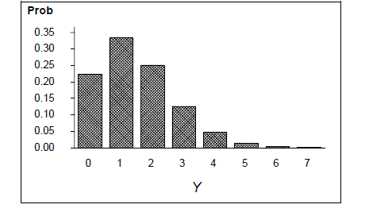
This distribution is the theoretical distribution when $μ=1,5$

Slide 14
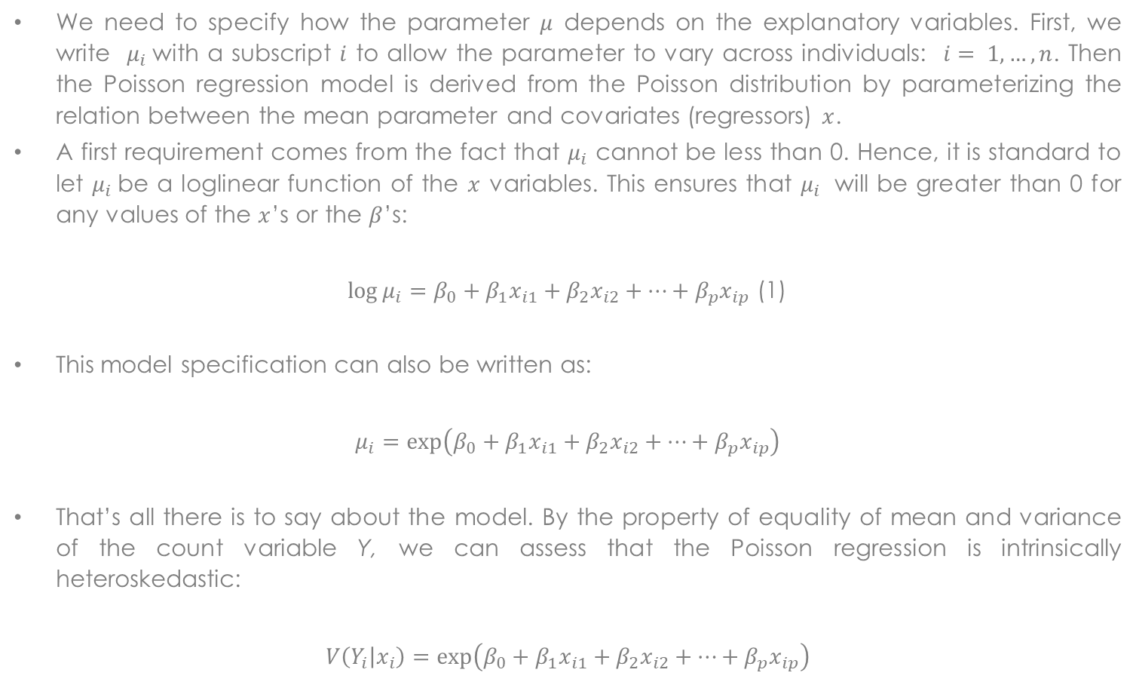
The Poisson regression model (2)
We need to specify how the parameter 𝜇 depends on the explanatory variables. First, we write $μ_{i}$with a subscript $i$ to allow the parameter to vary across individuals: $i= 1,…, n$. Then the Poisson regression model is derived from the Poisson distribution by parameterizing the relation between the mean parameter and covariates (regressors) $x$.
A first requirement comes from the fact that $μ_{i}$ cannot be less than 0. Hence, it is standard to let $μ_{i}$be a loglinear function of the $x$ variables. This ensures that $μ_{i}$ will be greater than 0 for any values of the $x$’s or the $β$’s:
$\log{μ_{i}=β_{0}+β_{1}x_{i1}+β_{2}x_{i2}+…+β_{p}x_{ip}}$ (1)
This model specification can also be written as:
$$μ_{i}=\exp\left(β_{0}+β_{1}x_{i1}+β_{2}x_{i2}+…+β_{p}x_{ip}\right)$$
That’s all there is to say about the model. By the property of equality of mean and variance of the count variable Y, we can assess that the Poisson regression is intrinsically heteroskedastic:
$$V\left(Y_{i} | x_{i}\right)=\exp\left(β_{0}+β_{1}x_{i1}+β_{2}x_{i2}+…+β_{p}x_{ip}\right)$$
Joseph Lanfranchi ISF 2021-22

Slide 15
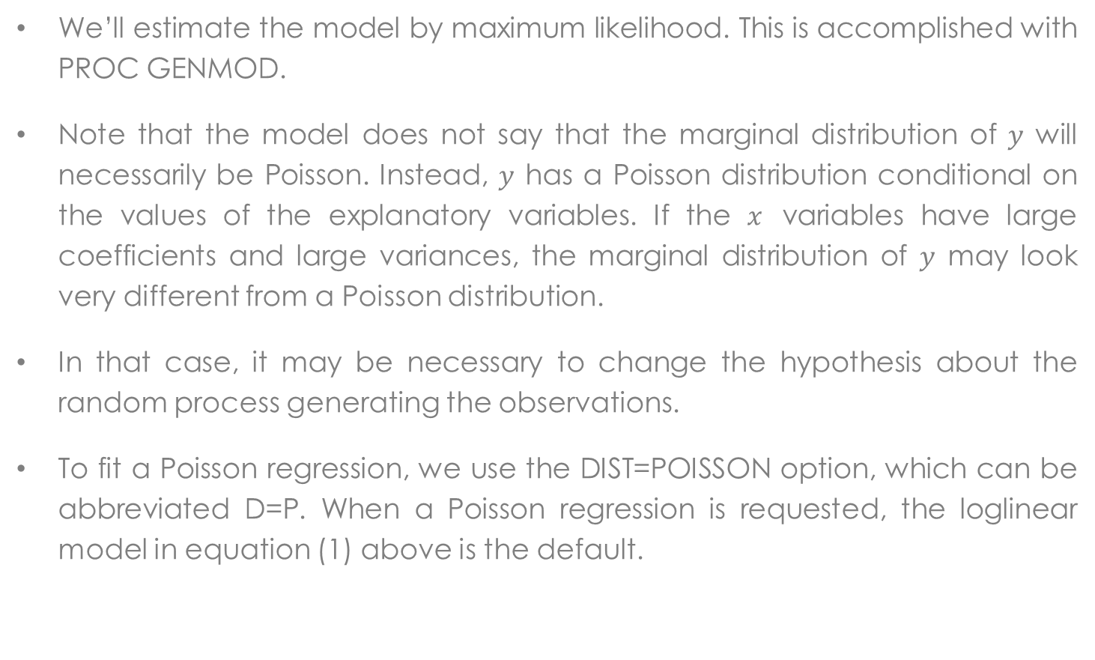
The Poisson regression model (3)
We’ll estimate the model by maximum likelihood. This is accomplished with PROC GENMOD.
Note that the model does not say that the marginal distribution of $y$ will necessarily be Poisson. Instead, $y$ has a Poisson distribution conditional on the values of the explanatory variables. If the $x$ variables have large coefficients and large variances, the marginal distribution of $y$ may look very different from a Poisson distribution.
In that case, it may be necessary to change the hypothesis about the random process generating the observations.
To fit a Poisson regression, we use the DIST=POISSON option, which can be abbreviated D=P. When a Poisson regression is requested, the loglinear model in equation (1) above is the default.
Joseph Lanfranchi ISF 2021-22

Slide 16
The Poisson regression model (4)
In the output we can see that all variables are significant to explain the number of doctor visits. Notice that the two private and social insurance have a positive effect on the extent of doctors visits. Among the other determinants of doctor visits, activity limitation and the number of chronic conditions have also positive effects, like manhood.
For the health professional visits, individuals privately insured are still visiting doctors more often but that is not the case of Medicaid utilizers. This social program does not pay for giving access to non doctor health care. Hence, the Medicaid dummy has to be interpreted as an indicator of having limited assets. Then, poor elderly people are not sufficiently wealthy to finance health professional visit.
Another change in the results: women are more likely to demand this type of visit than men.
Joseph Lanfranchi ISF 2021-22

Slide 17
Variable dépendante | docvis | # doctor visits
Analyse des paramètres estimés du maximum de vraisemblance
Paramètre | DDL | Estimation | Erreur type | Intervalle de confiance de Wald à95% |  | Khi-2 de Wald | Pr > khi-2
Intercept | 1 | -10.1210 | 0.9719 | -12.0259 | -8.2160 | 108.44 | <.0001
private | 1 | 0.1222 | 0.0144 | 0.0939 | 0.1505 | 71.59 | <.0001
medicaid | 1 | 0.1372 | 0.0193 | 0.0993 | 0.1750 | 50.34 | <.0001
age | 1 | 0.2962 | 0.0260 | 0.2453 | 0.3470 | 130.19 | <.0001
age2 | 1 | -0.0020 | 0.0002 | -0.0023 | -0.0016 | 128.30 | <.0001
educyr | 1 | 0.0249 | 0.0019 | 0.0211 | 0.0287 | 164.57 | <.0001
female | 1 | -0.0484 | 0.0131 | -0.0741 | -0.0226 | 13.56 | 0.0002
bh | 1 | -0.1596 | 0.0170 | -0.1928 | -0.1263 | 88.52 | <.0001
actlim | 1 | 0.1873 | 0.0146 | 0.1587 | 0.2159 | 165.18 | <.0001
totchr | 1 | 0.2487 | 0.0047 | 0.2396 | 0.2578 | 2855.92 | <.0001
Echelle | 0 | 1.0000 | 0.0000 | 1.0000 | 1.0000

Slide 18
Variable dépendante | nonphysician | #Visits to health professional, but not doctor
Analyse des paramètres estimés du maximum de vraisemblance
Paramètre | DDL | Estimation | Erreur type | Intervalle de confiance de Wald à95% |  | Khi-2 de Wald | Pr > khi-2
Intercept | 1 | -19.4884 | 1.5689 | -22.5634 | -16.4135 | 154.31 | <.0001
private | 1 | 0.1548 | 0.0222 | 0.1112 | 0.1984 | 48.47 | <.0001
medicaid | 1 | -0.3664 | 0.0375 | -0.4400 | -0.2929 | 95.25 | <.0001
age | 1 | 0.5070 | 0.0419 | 0.4249 | 0.5891 | 146.57 | <.0001
age2 | 1 | -0.0034 | 0.0003 | -0.0039 | -0.0028 | 145.75 | <.0001
educyr | 1 | 0.0787 | 0.0034 | 0.0721 | 0.0853 | 543.78 | <.0001
female | 1 | 0.0962 | 0.0209 | 0.0553 | 0.1371 | 21.25 | <.0001
bh | 1 | -0.4519 | 0.0308 | -0.5123 | -0.3914 | 214.57 | <.0001
actlim | 1 | 0.3443 | 0.0229 | 0.2994 | 0.3892 | 226.00 | <.0001
totchr | 1 | 0.2060 | 0.0075 | 0.1914 | 0.2207 | 759.53 | <.0001
Echelle | 0 | 1.0000 | 0.0000 | 1.0000 | 1.0000

Slide 19
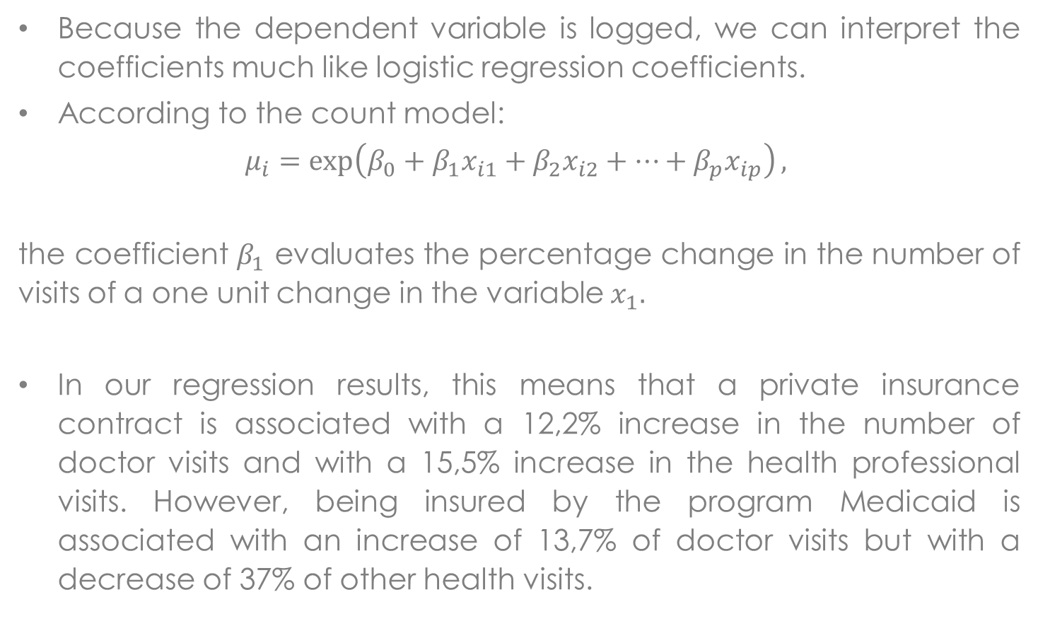
Meaning of estimated coefficients in the Poisson model
Because the dependent variable is logged, we can interpret the coefficients much like logistic regression coefficients.
According to the count model:
$$μ_{i}=\exp\left(β_{0}+β_{1}x_{i1}+β_{2}x_{i2}+…+β_{p}x_{ip}\right),$$
the coefficient $β_{1}$ evaluates the percentage change in the number of visits of a one unit change in the variable $x_{1}.$
In our regression results, this means that a private insurance contract is associated with a 12,2% increase in the number of doctor visits and with a 15,5% increase in the health professional visits. However, being insured by the program Medicaid is associated with an increase of 13,7% of doctor visits but with a decrease of 37% of other health visits.
Joseph Lanfranchi ISF 2021-22

Slide 20
Meaning of estimated coefficients in the Poisson model
Among the variables measuring the health state, suffering from physical limitation raises the number of doctor visits by 18,7%, while every supplementary chronic disease implies a 24,9% increase of these visits.
Women have 4,8% less doctor visits than men but 9,6% more health professional visits.
For the age, we can say that the effect is increasing then decreasing on the number of doctor visits with a maximum at 74,05 years old (-29.62/2*-0.20).
Joseph Lanfranchi ISF 2021-22

Slide 21
Overdispersion of observations
Overdispersion can be detected using the two goodness-of-fit chi-squares, the deviance and the Pearson chi-square. In the Poisson model, the variance of the dependent variable should be equal to its mean. In fact, the variance is often much higher than that. Hence, we must take into account the overdispersion of observations.
Note that in our results for the number of doctor visits, the deviance is 5 times as large as the number of degrees of freedom. This large ratio of deviance to degrees of freedom does suggest an overdispersion problem with the model.
To recognize an overdispersion problem, we take the ratio of the goodness-of-fit chi-square to its degrees of freedom, and compare the result with one. When those ratios are largely superior to unity, overdispersion of observations is very likely.
Joseph Lanfranchi ISF 2021-22

Slide 22
Variable dépendante | docvis | # doctor visits
Critères d'évaluation de l'adéquation
Critère | DDL | Valeur | Valeur/DDL
Ecart | 3667 | 18288.4460 | 4.9873
Déviance normalisée | 3667 | 18288.4460 | 4.9873
Khi2 de Pearson | 3667 | 23232.8352 | 6.3357
Pearson normalisé X2 | 3667 | 23232.8352 | 6.3357
Variable dépendante | nonphysician | #Visits to health professional, but not doctor
Critère | DDL | Valeur | Valeur/DDL
Ecart | 3667 | 27226.7059 | 7.4248
Déviance normalisée | 3667 | 27226.7059 | 7.4248
Khi2 de Pearson | 3667 | 79163.9009 | 21.5882
Pearson normalisé X2 | 3667 | 79163.9009 | 21.5882

Slide 23
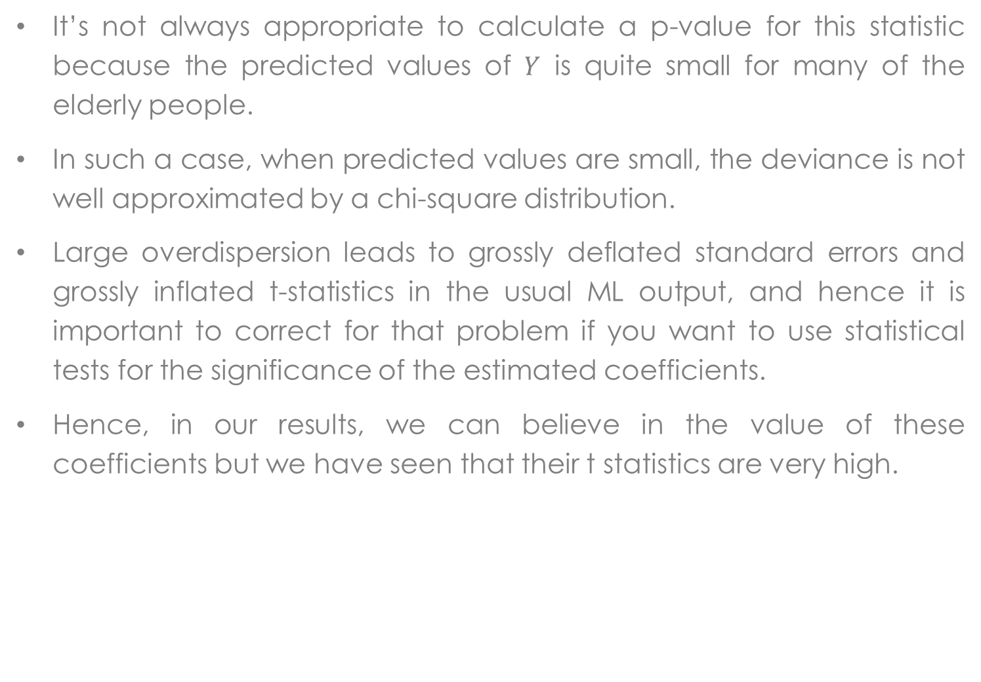
Overdispersion of observations
It’s not always appropriate to calculate a p-value for this statistic because the predicted values of $Y$ is quite small for many of the elderly people.
In such a case, when predicted values are small, the deviance is not well approximated by a chi-square distribution.
Large overdispersion leads to grossly deflated standard errors and grossly inflated t-statistics in the usual ML output, and hence it is important to correct for that problem if you want to use statistical tests for the significance of the estimated coefficients.
Hence, in our results, we can believe in the value of these coefficients but we have seen that their t statistics are very high.
Joseph Lanfranchi ISF 2021-22

Slide 24
Overdispersion of observations (II)
What can we do about the problem of overdispersion?
First, we have to remember that provided the conditional mean is correctly specified, the Poisson MLE is still consistent.
Hence, in a first step, it’s a simple matter to correct the standard errors and chi-squares.
It is then necessary to determine a dispersion parameter and increase the variance-covariance matrix of estimated parameters with the value of this parameter.
Joseph Lanfranchi ISF 2021-22

Slide 25
Overdispersion of observations (III)
The ratio of the goodness-of-fit chi-square to its degrees of freedom is estimated using the deviance or the Pearson chi-square. These dispersion parameters are fairly close, but the theory of MLE suggests the use of the Pearson chi-square.
Method: take the ratio of the goodness-of-fit chi-square to its degrees of freedom, and call the result C. Then, divide the chi-square statistic for each coefficient by C. Finally, multiply the standard error of each coefficient by the square root of C.
In Sas, the corrections just described can be automatically invoked by putting either SCALE=P (for Pearson) or SCALE=D (for deviance) as options in the MODEL statement of the proc GENMOD.
The only variable losing significance at 5% level is the individual gender, that does not explain the number of visits to any type of health practitioner.
Joseph Lanfranchi ISF 2021-22

Slide 26
Critère | DDL | Valeur | Valeur/DDL
Ecart | 3667 | 18288.4460 | 4.9873
Déviance normalisée | 3667 | 3667.0000 | 1.0000
Khi2 de Pearson | 3667 | 23232.8352 | 6.3357
Pearson normalisé X2 | 3667 | 4658.3951 | 1.2704
Critère | DDL | Valeur | Valeur/DDL
Ecart | 3667 | 27226.7059 | 7.4248
Déviance normalisée | 3667 | 3667.0000 | 1.0000
Khi2 de Pearson | 3667 | 79163.9009 | 21.5882
Pearson normalisé X2 | 3667 | 10662.1060 | 2.9076

Slide 27
Analyse des paramètres estimés du maximum de vraisemblance
Paramètre | DDL | Estimation | Erreur type | Intervalle de confiance de Wald à95% |  | Khi-2 de Wald | Pr > khi-2
Intercept | 1 | -10.1210 | 2.1705 | -14.3752 | -5.8668 | 21.74 | <.0001
private | 1 | 0.1222 | 0.0322 | 0.0590 | 0.1854 | 14.35 | 0.0002
medicaid | 1 | 0.1372 | 0.0432 | 0.0525 | 0.2218 | 10.09 | 0.0015
age | 1 | 0.2962 | 0.0580 | 0.1825 | 0.4098 | 26.11 | <.0001
age2 | 1 | -0.0020 | 0.0004 | -0.0027 | -0.0012 | 25.73 | <.0001
educyr | 1 | 0.0249 | 0.0043 | 0.0164 | 0.0334 | 33.00 | <.0001
female | 1 | -0.0484 | 0.0293 | -0.1059 | 0.0091 | 2.72 | 0.0991
bh | 1 | -0.1596 | 0.0379 | -0.2338 | -0.0853 | 17.75 | <.0001
actlim | 1 | 0.1873 | 0.0325 | 0.1235 | 0.2511 | 33.12 | <.0001
totchr | 1 | 0.2487 | 0.0104 | 0.2283 | 0.2690 | 572.64 | <.0001
Echelle | 0 | 2.2332 | 0.0000 | 2.2332 | 2.2332

Slide 28
Analyse des paramètres estimés du maximum de vraisemblance
Paramètre | DDL | Estimation | Erreur type | Intervalle de confiance de Wald à 95% |  | Khi-2 de Wald | Pr > khi-2
Intercept | 1 | -19.4884 | 4.2749 | -27.8672 | -11.1097 | 20.78 | <.0001
private | 1 | 0.1548 | 0.0606 | 0.0361 | 0.2736 | 6.53 | 0.0106
medicaid | 1 | -0.3664 | 0.1023 | -0.5670 | -0.1659 | 12.83 | 0.0003
age | 1 | 0.5070 | 0.1141 | 0.2834 | 0.7307 | 19.74 | <.0001
age2 | 1 | -0.0034 | 0.0008 | -0.0048 | -0.0019 | 19.63 | <.0001
educyr | 1 | 0.0787 | 0.0092 | 0.0607 | 0.0967 | 73.24 | <.0001
female | 1 | 0.0962 | 0.0569 | -0.0153 | 0.2077 | 2.86 | 0.0907
bh | 1 | -0.4519 | 0.0841 | -0.6166 | -0.2871 | 28.90 | <.0001
actlim | 1 | 0.3443 | 0.0624 | 0.2220 | 0.4666 | 30.44 | <.0001
totchr | 1 | 0.2060 | 0.0204 | 0.1661 | 0.2460 | 102.30 | <.0001

Slide 29
Some proximity with the OLS
Ordinary linear regression is not susceptible to the problem of overdispersion because it automatically estimates a scale parameter that is used in calculating standard errors and test statistics. The scale parameter for a linear regression is just the estimated standard deviation of the disturbance term, sometimes called the root mean squared error.
To illustrate this point, we can use ordinary least squares (OLS) to regress the two models and the results, while not identical to those in previous output, are quite close, as we can see from the age effect (max at 77,35).
In general, Poisson regression with a correction for overdispersion is better than ordinary least squares but OLS may be better than Poisson regression without the overdispersion correction.
Joseph Lanfranchi ISF 2021-22

Slide 30
Analyse des paramètres estimés du maximum de vraisemblance
Paramètre | DDL | Estimation | Erreur type | Intervalle de confiance de Wald à95% |  | Khi-2 de Wald | Pr > khi-2
Intercept | 1 | -11.2128 | 2.3180 | -15.7560 | -6.6695 | 23.40 | <.0001
private | 1 | 0.1837 | 0.0349 | 0.1153 | 0.2520 | 27.75 | <.0001
medicaid | 1 | 0.1224 | 0.0484 | 0.0276 | 0.2172 | 6.40 | 0.0114
age | 1 | 0.3101 | 0.0620 | 0.1886 | 0.4317 | 25.01 | <.0001
age2 | 1 | -0.0020 | 0.0004 | -0.0028 | -0.0012 | 24.23 | <.0001
educyr | 1 | 0.0219 | 0.0047 | 0.0128 | 0.0311 | 22.22 | <.0001
female | 1 | 0.0327 | 0.0321 | -0.0302 | 0.0956 | 1.04 | 0.3086
bh | 1 | -0.2014 | 0.0402 | -0.2802 | -0.1225 | 25.08 | <.0001
actlim | 1 | 0.1435 | 0.0372 | 0.0707 | 0.2164 | 14.91 | 0.0001
totchr | 1 | 0.3329 | 0.0124 | 0.3086 | 0.3573 | 717.99 | <.0001
Echelle | 1 | 0.9405 | 0.0110 | 0.9192 | 0.9622

Slide 31
Analyse des paramètres estimés du maximum de vraisemblance
Paramètre | DDL | Estimation | Erreur type | Intervalle de confiance de Wald à95% |  | Khi-2 de Wald | Pr > khi-2
Intercept | 1 | -12.3955 | 2.7055 | -17.6981 | -7.0929 | 20.99 | <.0001
private | 1 | 0.1342 | 0.0407 | 0.0545 | 0.2140 | 10.88 | 0.0010
medicaid | 1 | -0.2167 | 0.0565 | -0.3274 | -0.1060 | 14.72 | 0.0001
age | 1 | 0.3189 | 0.0724 | 0.1771 | 0.4608 | 19.42 | <.0001
age2 | 1 | -0.0021 | 0.0005 | -0.0031 | -0.0012 | 19.80 | <.0001
educyr | 1 | 0.0474 | 0.0054 | 0.0368 | 0.0580 | 76.16 | <.0001
female | 1 | 0.1311 | 0.0375 | 0.0576 | 0.2045 | 12.24 | 0.0005
bh | 1 | -0.3710 | 0.0469 | -0.4630 | -0.2790 | 62.49 | <.0001
actlim | 1 | 0.0634 | 0.0434 | -0.0217 | 0.1484 | 2.13 | 0.1441
totchr | 1 | 0.1578 | 0.0145 | 0.1293 | 0.1862 | 118.38 | <.0001
Echelle | 1 | 1.0977 | 0.0128 | 1.0728 | 1.1230

Slide 32
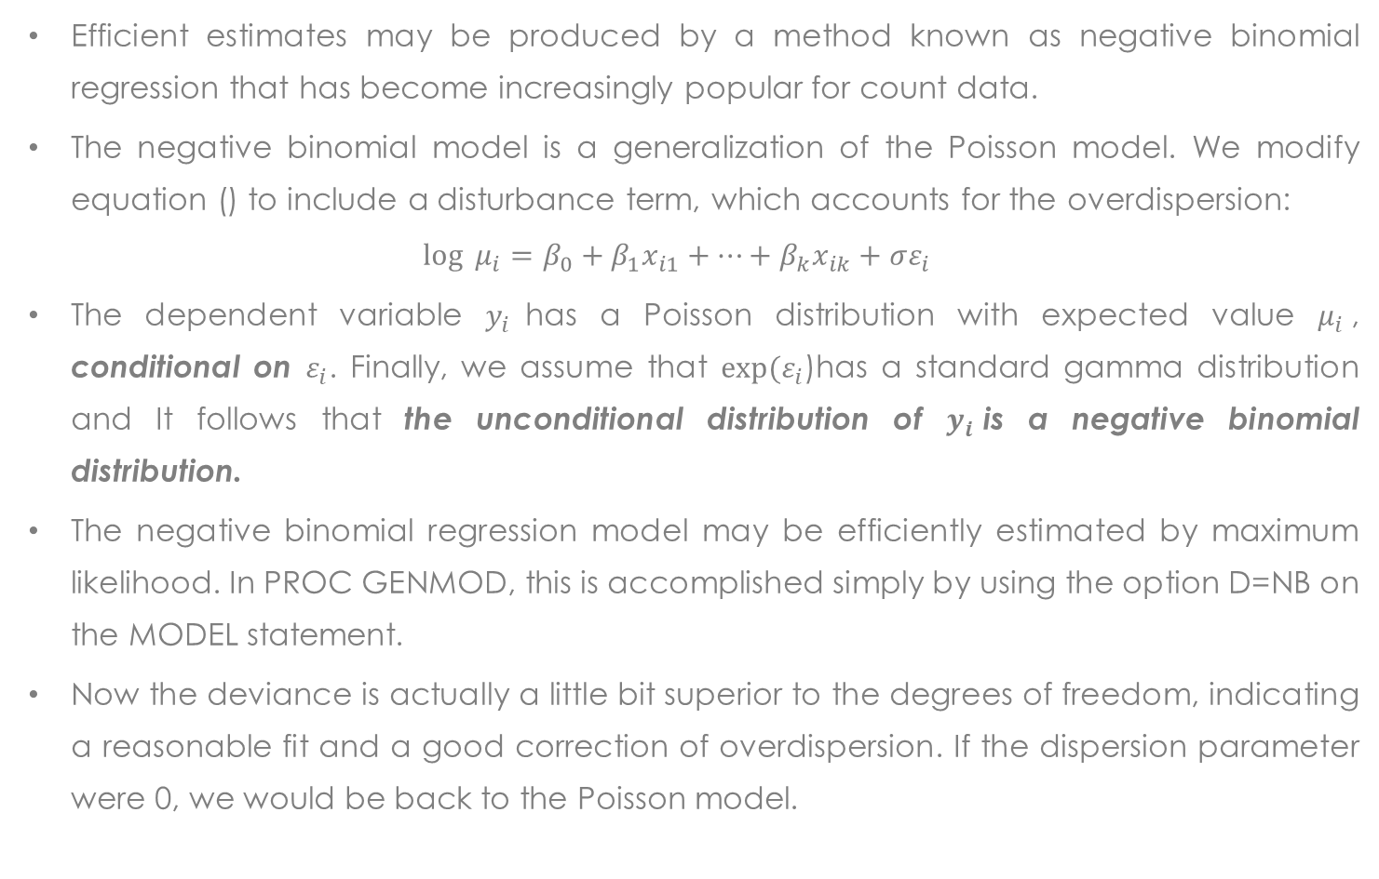
Adjustment of overdispersion with Negative Binomial Regression
Efficient estimates may be produced by a method known as negative binomial regression that has become increasingly popular for count data.
The negative binomial model is a generalization of the Poisson model. We modify equation () to include a disturbance term, which accounts for the overdispersion:
$$\log{ μ_{i}=β_{0}+β_{1}x_{i1}+…+β_{k}x_{ik}+σε_{i} }$$
The dependent variable $y_{i}$has a Poisson distribution with expected value $μ_{i}$, conditional on $ε_{i}$. Finally, we assume that $exp⁡(ε_{i}$)has a standard gamma distribution and It follows that the unconditional distribution of $y_{i}$is a negative binomial distribution.
The negative binomial regression model may be efficiently estimated by maximum likelihood. In PROC GENMOD, this is accomplished simply by using the option D=NB on the MODEL statement.
Now the deviance is actually a little bit superior to the degrees of freedom, indicating a reasonable fit and a good correction of overdispersion. If the dispersion parameter were 0, we would be back to the Poisson model.
Joseph Lanfranchi ISF 2021-22

Slide 33
Negative Binomial Regression
You can get a test for whether the dispersion parameter is 0 by putting the option NOSCALE on the MODEL statement. This constrains the dispersion parameter to be 0 and reports a Lagrange multiplier test for that constraint.
For this example, we get a chisquare of 1715,6 with one degree of freedom, which is highly significant. So we reject the simpler Poisson model in favor of the more complicated negative binomial model.
In this new model, the precision of the estimated parameters has improved with the p-values of the significant variables noticeably lower.
The logic of the results for the model explaining the number of visits to health professionals is quite similar with a low ratio deviance / number of degrees of freedom (less than 1).
This globally confirms the superiority of the negative binomial model.
Joseph Lanfranchi ISF 2021-22

Slide 34
Critères d'évaluation de l'adéquation
Critère | DDL | Valeur | Valeur/DDL
Ecart | 3667 | 4196.3454 | 1.1444
Déviance normalisée | 3667 | 4196.3454 | 1.1444
Khi2 de Pearson | 3667 | 4688.4230 | 1.2785
Pearson normalisé X2 | 3667 | 4688.4230 | 1.2785
Critère | DDL | Valeur | Valeur/DDL
Ecart | 3667 | 18288.4460 | 4.9873
Déviance normalisée | 3667 | 18288.4460 | 4.9873
Khi2 de Pearson | 3667 | 23232.8352 | 6.3357
Pearson normalisé X2 | 3667 | 23232.8352 | 6.3357
Statistiques du multiplicateur de Lagrange
Paramètre | Khi-2 | Pr > khi-2
Dispersion | 1715.6332 | <.0001 | *
* p-value unilatérale

Slide 35
Analyse des paramètres estimés du maximum de vraisemblance
Paramètre | DDL | Estimation | Erreur type | Intervalle de confiance de Wald à95% |  | Khi-2 de Wald | Pr > khi-2
Intercept | 1 | -10.1363 | 2.2437 | -14.5339 | -5.7386 | 20.41 | <.0001
private | 1 | 0.1491 | 0.0334 | 0.0836 | 0.2146 | 19.92 | <.0001
medicaid | 1 | 0.1470 | 0.0468 | 0.0553 | 0.2387 | 9.87 | 0.0017
age | 1 | 0.2941 | 0.0600 | 0.1764 | 0.4118 | 23.99 | <.0001
age2 | 1 | -0.0019 | 0.0004 | -0.0027 | -0.0012 | 23.48 | <.0001
educyr | 1 | 0.0231 | 0.0044 | 0.0144 | 0.0317 | 27.14 | <.0001
female | 1 | -0.0090 | 0.0306 | -0.0690 | 0.0510 | 0.09 | 0.7677
bh | 1 | -0.1624 | 0.0399 | -0.2407 | -0.0841 | 16.53 | <.0001
actlim | 1 | 0.1875 | 0.0347 | 0.1195 | 0.2555 | 29.23 | <.0001
totchr | 1 | 0.2768 | 0.0121 | 0.2531 | 0.3006 | 520.62 | <.0001
Dispersion | 1 | 0.6367 | 0.0196 | 0.5994 | 0.6762

Slide 36
Zero inflated models of count data
For some applications, the number of individuals with a count of zero may be a large fraction of the sample.
In the data set just examined, a little more than 10 percent of the patients had zero visits to a doctor. For those patients older than 65, 53 percent never visited any non doctor health professional.
Poisson regression models often fit poorly when the fraction of zeros is large. This has led to the development of zero-inflated Poisson regression models (ZIP model) which give special treatment to the zero counts.
The zero-inflated Poisson (ZIP) model is now available in PROC GENMOD, along with a zero-inflated negative binomial model.
Joseph Lanfranchi ISF 2021-22

Slide 37
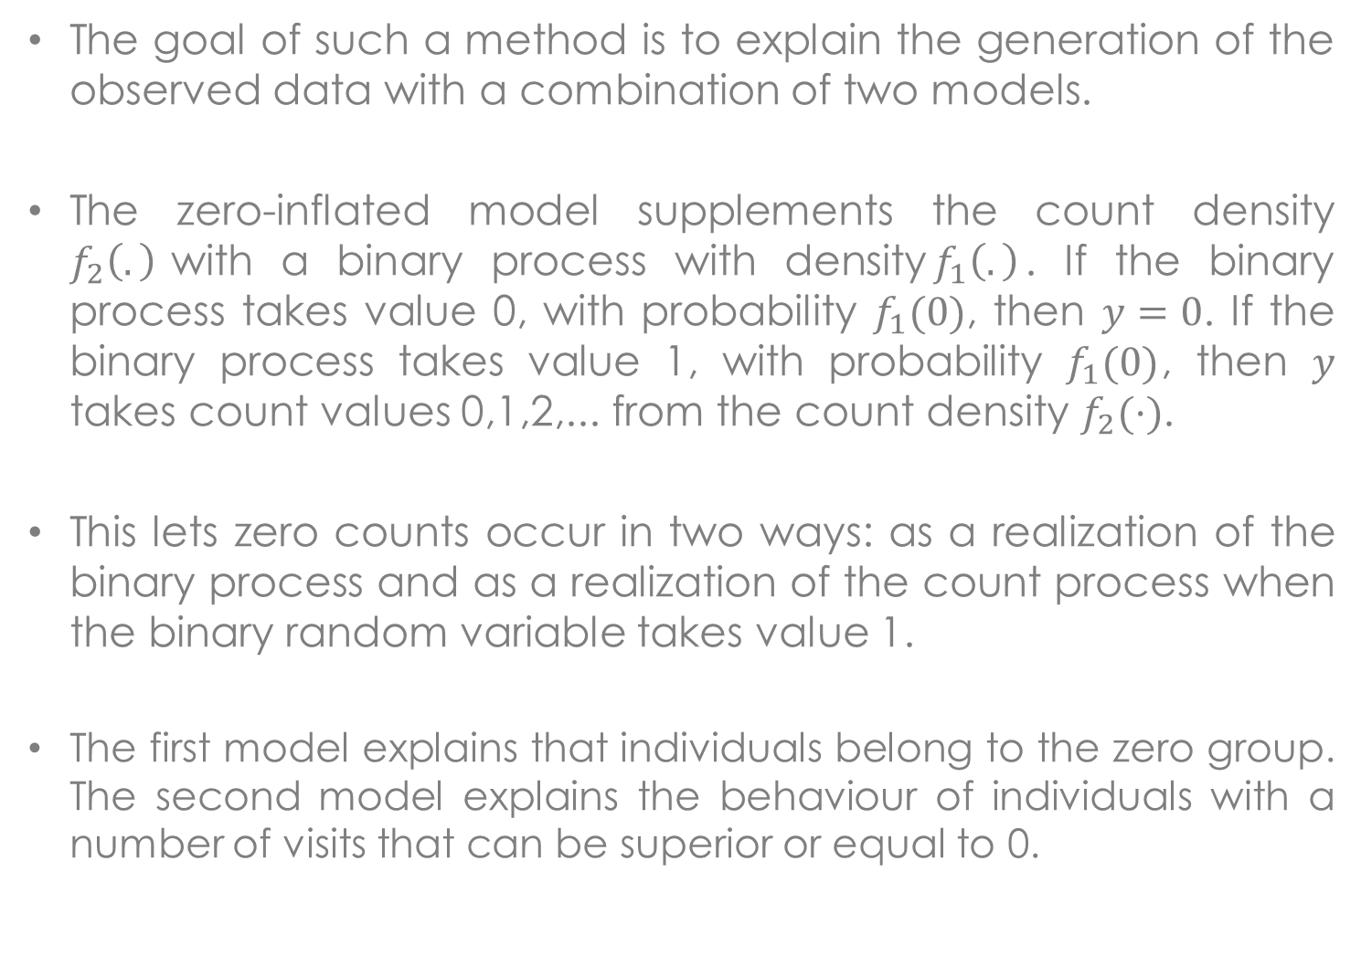
Zero inflated models of count data
The goal of such a method is to explain the generation of the observed data with a combination of two models.
The zero-inflated model supplements the count density $f_{2}\left(.\right)$with a binary process with density$f_{1}\left(.\right)$. If the binary process takes value 0, with probability $f_{1}(0)$, then $y=0$. If the binary process takes value 1, with probability $f_{1}(0)$, then $y$ takes count values 0,1,2,... from the count density $f_{2}(·)$.
This lets zero counts occur in two ways: as a realization of the binary process and as a realization of the count process when the binary random variable takes value 1.
The first model explains that individuals belong to the zero group. The second model explains the behaviour of individuals with a number of visits that can be superior or equal to 0.
Joseph Lanfranchi ISF 2021-22

Slide 38
Zero inflated models of count data (2)
This sort of model is sometimes called a finite mixture model. It can be estimated by maximum likelihood, even though we can’t distinguish with certainty whether individuals with counts of zero are in one group or the other.
In addition to the usual regression coefficients (for the individuals in the regression group), we can get an estimate of the probability that an individual is in the zero group. And we can elaborate the models further by allowing the probability of being in the zero group to be a function of covariates, usually via logistic regression.
Here is an example of a zero inflated Poisson model explaining the doctor visits, but with no set of explanatory variable for the binary model explaining that individuals belong to the zero group :
proc genmod data=lib.docvisit;
model nonphysician = private medicaid age age2 educyr female phylim totchr / D=ZIP;
zeromodel;
run;
Joseph Lanfranchi ISF 2021-22

Slide 39
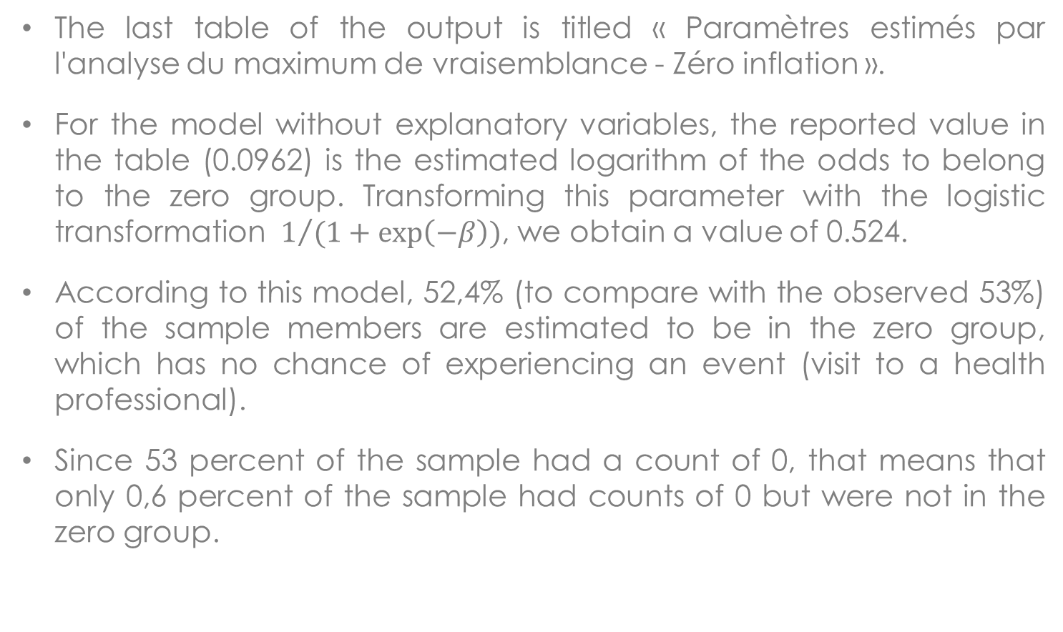
Zero inflated models of count data (3)
The last table of the output is titled « Paramètres estimés par l'analyse du maximum de vraisemblance - Zéro inflation ».
For the model without explanatory variables, the reported value in the table (0.0962) is the estimated logarithm of the odds to belong to the zero group. Transforming this parameter with the logistic transformation $1/{(1+\exp\left(−β\right))}$, we obtain a value of 0.524.
According to this model, 52,4% (to compare with the observed 53%) of the sample members are estimated to be in the zero group, which has no chance of experiencing an event (visit to a health professional).
Since 53 percent of the sample had a count of 0, that means that only 0,6 percent of the sample had counts of 0 but were not in the zero group.
Joseph Lanfranchi ISF 2021-22

Slide 40
Analyse des paramètres estimés du maximum de vraisemblance
Paramètre | DDL | Estimation | Erreur type | Intervalle de confiance de Wald à95% |  | Khi-2 de Wald | Pr > khi-2
Intercept | 1 | -12.7201 | 1.6402 | -15.9348 | -9.5054 | 60.15 | <.0001
private | 1 | 0.0297 | 0.0225 | -0.0144 | 0.0739 | 1.74 | 0.1867
medicaid | 1 | -0.1113 | 0.0395 | -0.1888 | -0.0338 | 7.92 | 0.0049
age | 1 | 0.3614 | 0.0438 | 0.2755 | 0.4472 | 68.13 | <.0001
age2 | 1 | -0.0024 | 0.0003 | -0.0029 | -0.0018 | 66.05 | <.0001
educyr | 1 | 0.0345 | 0.0035 | 0.0275 | 0.0414 | 94.62 | <.0001
female | 1 | -0.0179 | 0.0213 | -0.0596 | 0.0239 | 0.70 | 0.4019
bh | 1 | 0.0179 | 0.0322 | -0.0452 | 0.0810 | 0.31 | 0.5776
actlim | 1 | 0.3124 | 0.0230 | 0.2674 | 0.3575 | 184.77 | <.0001
totchr | 1 | 0.1007 | 0.0077 | 0.0855 | 0.1159 | 169.08 | <.0001
Echelle | 0 | 1.0000 | 0.0000 | 1.0000 | 1.0000
Paramètres estimés par l'analyse du maximum de vraisemblance
Paramètre | DDL | Estimation | Erreur type | Intervalle de confiance de Wald à 95% |  | Khi-2 de Wald | Pr > khi-2
Intercept | 1 | 0.0962 | 0.0335 | 0.0305 | 0.1618 | 8.25

Slide 41
Zero inflated models of count data (4)
We can then introduce variables to explain why individuals could belong to the zero group.
For example here, we have explained this fact with the whole set of explanatory variables of the count model.
For example, a private insurance contract reduces the probability to report a zero but increases the expected number of visits. Being insured with Medicaid on the contrary increases the probability to be part of the zero group but decreases the expected number of visits for those outside the zero group.
Another result, being a woman decreases the probability to belong to the zero group but has no effect on the number of visits.
The higher the number of chronic conditions, the less likely to belong to the zero group and the higher the expected number to health professionals.
Joseph Lanfranchi ISF 2021-22

Slide 42
Analyse des paramètres estimés du maximum de vraisemblance
Paramètre | DDL | Estimation | Erreur type | Intervalle de confiance de Wald à 95% |  | Khi-2 de Wald | Pr > khi-2
Intercept | 1 | -11.1841 | 1.6198 | -14.3588 | -8.0094 | 47.68 | <.0001
private | 1 | 0.0127 | 0.0223 | -0.0311 | 0.0564 | 0.32 | 0.5709
medicaid | 1 | -0.0874 | 0.0376 | -0.1611 | -0.0137 | 5.40 | 0.0201
age | 1 | 0.3229 | 0.0432 | 0.2381 | 0.4077 | 55.75 | <.0001
age2 | 1 | -0.0021 | 0.0003 | -0.0027 | -0.0016 | 54.11 | <.0001
educyr | 1 | 0.0282 | 0.0034 | 0.0216 | 0.0348 | 69.55 | <.0001
female | 1 | -0.0364 | 0.0212 | -0.0779 | 0.0051 | 2.96 | 0.0853
phylim | 1 | 0.2734 | 0.0227 | 0.2290 | 0.3179 | 145.20 | <.0001
totchr | 1 | 0.0995 | 0.0077 | 0.0843 | 0.1146 | 165.47 | <.0001
Echelle | 0 | 1.0000 | 0.0000 | 1.0000 | 1.0000

Slide 43
Paramètres estimés par l'analyse du maximum de vraisemblance
Paramètre | DDL | Estimation | Erreur type | Intervalle de confiance de Wald à 95% |  | Khi-2 de Wald | Pr > khi-2
Intercept | 1 | 16.4669 | 5.2809 | 6.1166 | 26.8173 | 9.72 | 0.0018
private | 1 | -0.3704 | 0.0770 | -0.5213 | -0.2196 | 23.16 | <.0001
medicaid | 1 | 0.6415 | 0.1129 | 0.4203 | 0.8628 | 32.29 | <.0001
age | 1 | -0.3847 | 0.1412 | -0.6614 | -0.1080 | 7.43 | 0.0064
age2 | 1 | 0.0026 | 0.0009 | 0.0007 | 0.0044 | 7.56 | 0.0060
educyr | 1 | -0.1179 | 0.0108 | -0.1390 | -0.0968 | 120.00 | <.0001
female | 1 | -0.2424 | 0.0733 | -0.3861 | -0.0987 | 10.93 | 0.0009
phylim | 1 | -0.2424 | 0.0792 | -0.3977 | -0.0871 | 9.36 | 0.0022
totchr | 1 | -0.2451 | 0.0287 | -0.3014 | -0.1889 | 72.95 | <.0001

Slide 44
 | Poisson | ZIP | NB | ZINB | ZIP with Expl. | ZINB with expl.
Full Log- vraisemblance | -15011.4 | -12427.39 | -6724.17 | -6724.17 | -12225.82 | -6667.44
BIC | 30096.86 | 24936.88 | 13530.43 | 13538.64 | 24599.42 | 13490.88
The model with the best log likelihood and the weakest BIC statistic is the ZINB model with explanatory variables.

